Slide 1
ECMAScript
Varun Kumar
ES Video tutorial - youtube.com/watch?v=D_t63AZIZQA

Slide 2
Table of Content
Basic introduction of EcmaScript
Overview of ECMAScript Versions
Key Features of ECMAScript 6 (ES6)
Subsequent ECMAScript Versions
Recent and Future ECMAScript Features
Webpack module bundler
Babel
ES6 Project Structure

Slide 3
Basic introduction of EcmaScript
ECMA International - European Computer Manufacturers Association
ECMA-262 is a standard publish by ECMA that specifies a general purpose scripting language.
This standard(ES) defines the rules, details and guidelines that the scripting language must observe to be considered ES compliant.
EcmaScript specification is a blueprint for creating a scripting language.
JavaScript is the most popular implementation of ECMAScript.
ECMAScript defines the language features and syntax that browsers must support.
Notes:
1. Organization that develops standard for different technologies.
2. Operating from 1961.
3. ECMA-262 is a standard publish by ECMA that specifies a general purpose scripting language.
4. This standard(ES) defines the rules, details and guidelines that the scripting language must observe to be considered ES compliant.
5. EcmaScript specification is a blueprint for creating a scripting language.

Slide 4
Overview of ECMAScript Versions
ES6 is the 6th edition of the EcmaScript, standardized in 2015.
ES6 Provide better code structure, readability then previous version i.e. ES5
ES6 Introduces new features like arrow function, spread operator, block scope etc.
Currently the ES version is 2024 (ES15, released in July 2024)
Other ES versions -
ES7/ES2016
ES8/ES2017
ES9/ES2018
ES10/ES2019
ES11/ES2020
ES12/ES2021
ES13/ES2022
ES14/ES2023

Slide 5
Key Features of ECMAScript 6 (ES6)
Block-Scoped variables (let and const)
Arrow Function and Default Parameterized Function
Enhanced object literals
Template literals
Destructuring assignment
Spread/Rest operator
Classes
Modules

Slide 6
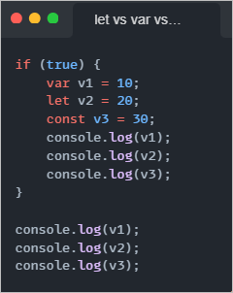
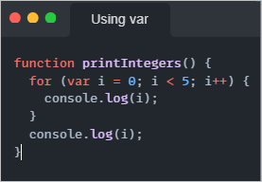
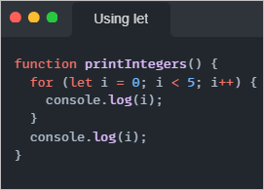
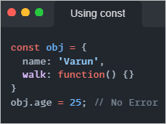
Block-Scoped variables (let and const)
Always use let to declare variables until or unless there are reasons to use var.
Cannot define a variable with same name again in same scope using let.
Notes:
In JS whole document is Global scope and all other things like variables, functions are combined in this global scope.
And second is local scope, variables defined inside a function are considered as Local Scope which is further divided into two parts.
1. Block Scope - inside curly braces or for loop.
2. Functional Scope. - inside function.
ES6 provides two new keywords for declaring variables that are only accessible inside a block.

Slide 7
Functions
A function is a block of organized code that is used to perform a single task.
It provides better modularity and reusability and maintainability.
Functions were already available in ES but ES6 provided 2 new features
Arrow Function
Default Parameterized Functions

Slide 8
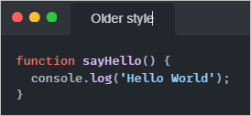
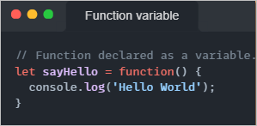
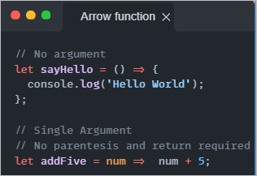
Arrow Function
Allows us to write shorter function syntax.

Slide 9
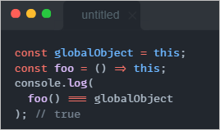
Arrow Function and this keyword
The value of this is not the object that has the function as an own property, but the object that is used to call the function.
In arrow functions, this retains the value of the enclosing lexical context's this.
In other words, when evaluating an arrow function's body, the language does not create a new this binding.

Slide 10
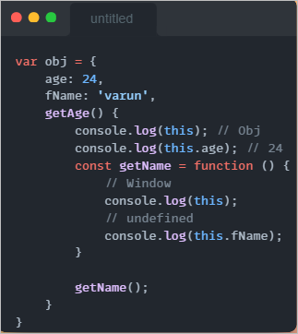
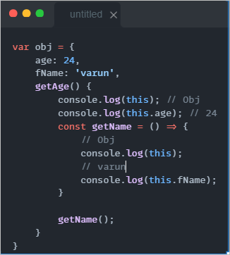
Arrow Function and this keyword

Slide 11
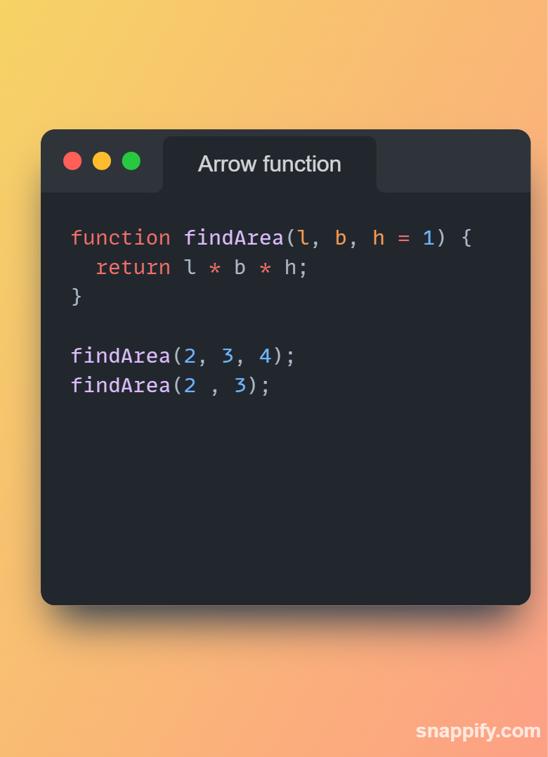
Default Parameterized Function

Slide 12
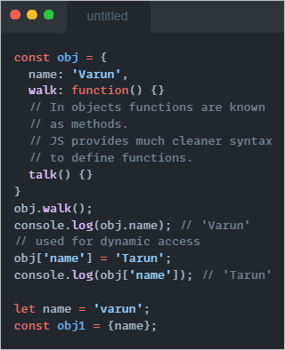
Enhanced object literals
To ways to access properties and methods of objects.
Dot notation
Bracket notation.

Slide 13
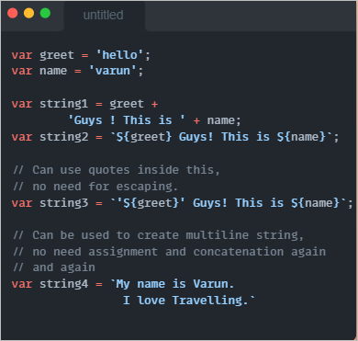
Template literals
Used to create dynamic strings.
Also known as string literals
Multiline string is allowed using backtick operator (`)
Expression can be included using ${expression}

Slide 14
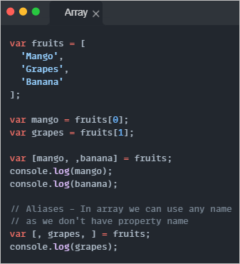
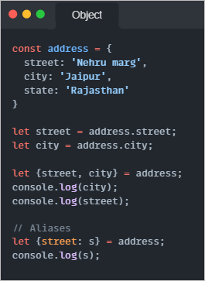
Destructuring assignment
Two types -
Array Destructuring
Object Destructuring
Useful when interested in some properties.
We can use aliases.

Slide 15
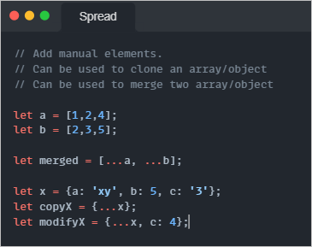
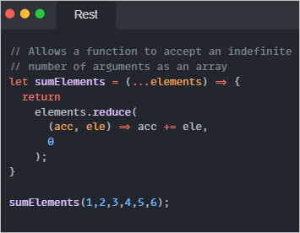
Spread/Rest operator
Notes:
let SumElements = (...arr) => {
console.log(arr); // [10, 20, 40, 60, 90]
let sum = 0;
for (let element of arr) {
sum += element;
}
console.log(sum); // 220.
}
SumElements(10, 20, 40, 60, 90); // Note we are not passing array here. Instead we are passing the elements as arguments.
Math.max(10, 20, 60, 100, 50, 200); // returns 200.
let arr = [10, 20, 60];
Math.max(arr); // Shows error. Doesn't accept an array.
let arr = [10, 20, 60];
Math.max(...arr); // 60

Slide 16
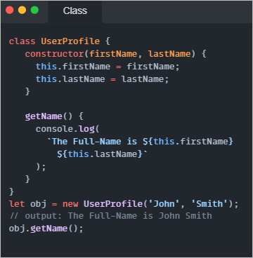
Classes
ES6 Classes formalize the common JavaScript pattern of simulating class-like inheritance hierarchies using functions and prototypes.
They are effectively simple sugaring over prototype-based OO, offering a convenient declarative form for class patterns which encourage interoperability.
By this we will be able to support OOPS concept.

Slide 17
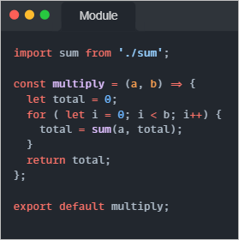
Modules
Module allow you to split code in parts.
Improves code management and code reusability.
We can use the "import" or "export" statement in a module to import or export variables, functions, classes or any other component from/to different files and modules.

Slide 18
Subsequent ECMAScript Versions
ES7 onwards
Object.values() and Object.entries()
Exponentiation operator (**)
Array.prototype.includes()
Trailing Commas

Slide 19
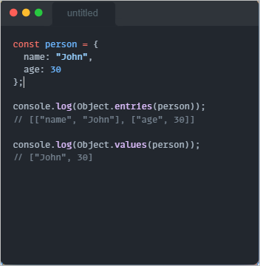
Object.values() and Object.entries()

Slide 20
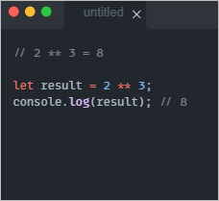
Exponentiation operator (**)

Slide 21
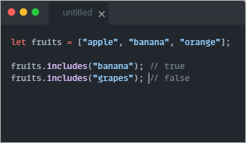
Array.prototype.includes()
Array.prototype.includes() lets you check if an array has a specific item. It tells you yes (true) or no (false), which is simpler than the old way using indexOf().

Slide 22
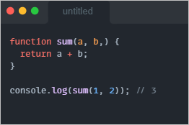
Trailing Commas
Trailing commas (sometimes called "final commas") can be useful when adding new elements, parameters, or properties to JavaScript code. If you want to add a new property, you can add a new line without modifying the previously last line if that line already uses a trailing comma. This makes version-control diffs cleaner and editing code might be less troublesome.
JavaScript has allowed trailing commas in array literals since the beginning. Trailing commas are now also allowed in object literals, function parameters, named imports, named exports, and more.

Slide 23
Recent and Future ECMAScript Features
ES2020/ ES11
Optional chaining (?.)
Nullish coalescing operator (??)
ES2021/ ES12
String.prototype.replaceAll()
Logical Assignment Operators (||=, &&=, ??=)

Slide 24
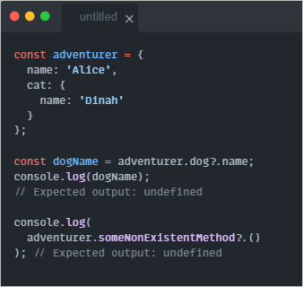
Optional chaining (?.)
The optional chaining (?.) operator accesses an object's property or calls a function. If the object accessed or function called using this operator is undefined or null, the expression short circuits and evaluates to undefined instead of throwing an error.

Slide 25
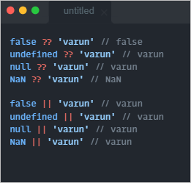
Nullish coalescing operator (??)
Nullish coalescing adds the ability to truly check nullish values instead of falsey values. What is the difference between nullish and falsy values, you might ask?
In JavaScript, a lot of values are falsey, like empty strings, the number 0, undefined, null, false, NaN, and so on.
However, a lot of times you might want to check if a variable is nullish – that is if it is either undefined or null, like when it's okay for a variable to have an empty string, or even a false value.

Slide 26
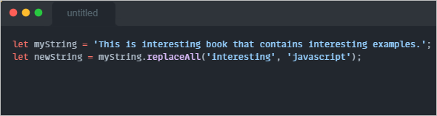
String.prototype.replaceAll()

Slide 27
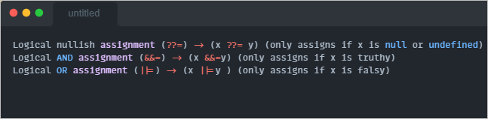
Logical Assignment Operators (||=, &&=, ??=)

Slide 28
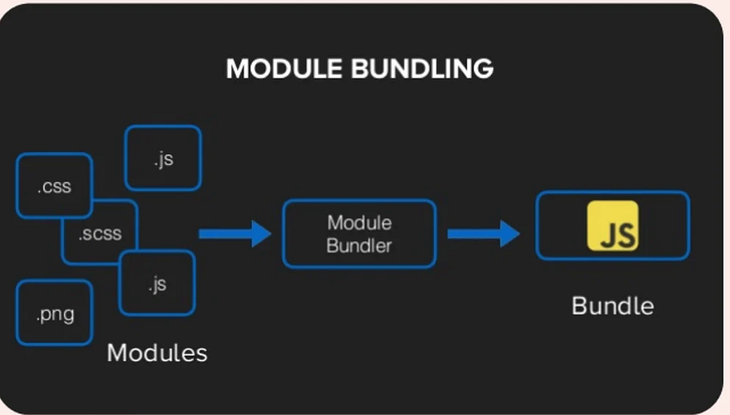
Webpack module bundler
Webpack is module bundler tool that is used to make a single file from multiple JS modules.
Uses different loader to fulfill the task (like minification, concatenation etc.)
Works on resolve & reject approach
If module is not available Promise is rejected.
Webpack takes modules with dependencies and generates static assets representing those modules.

Slide 29
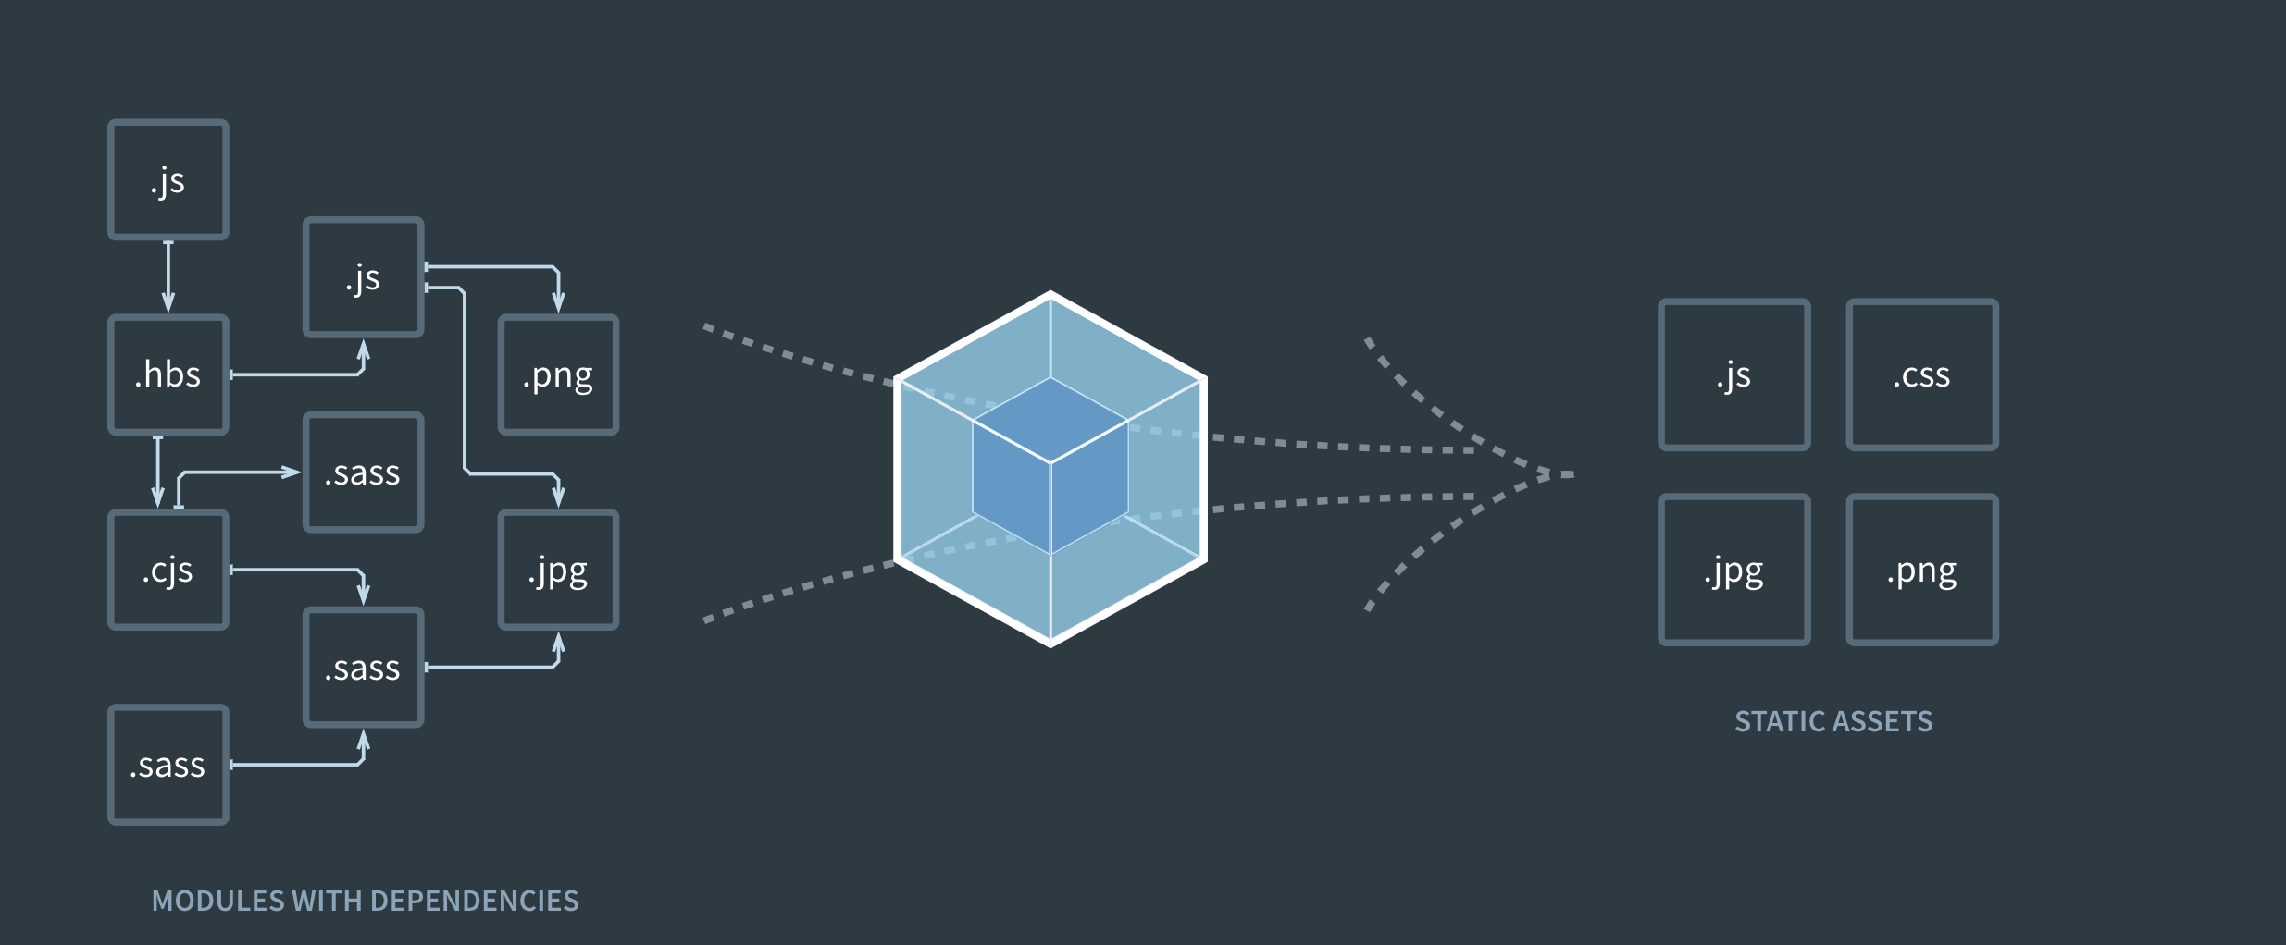
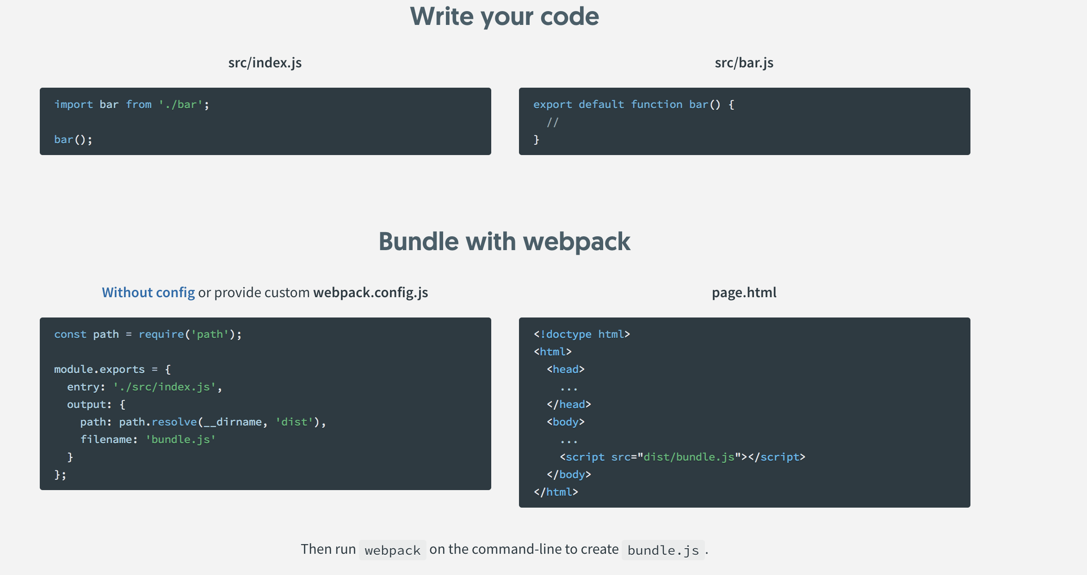
Webpack

Slide 30
Webpack module bundler
So when dependencies are complex between various components Webpack is real winner to bundle application code.
It internally builds the dependency graph between modules to bundle the code.
Way to organize and combine many files of JS code into one file.
Can be used when project becomes too large for a single file or when you're working with libraries that have multiple dependencies.
Problem Example
Solution Example

Slide 31
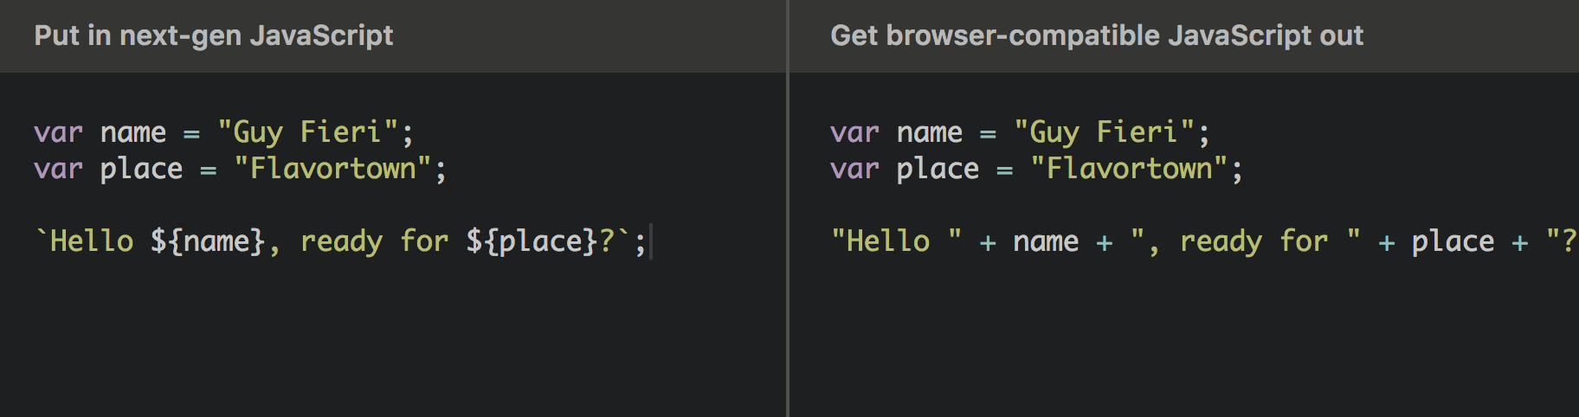
Babel
Babel is javascript compiler. Babel is a toolchain that is mainly used to convert ECMAScript 2015+ code into a backwards compatible version of JavaScript in current and older browsers or environments.

Slide 32
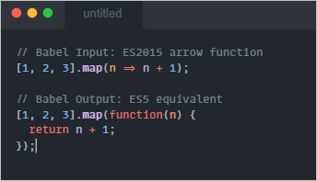
Babel (Examples)

Slide 33
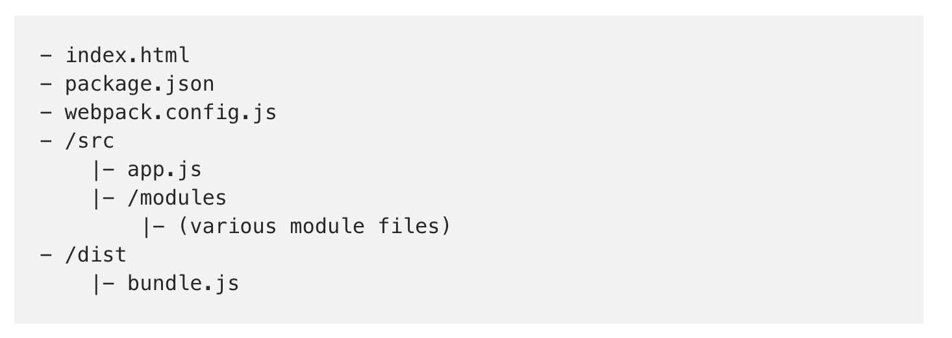
Es6 Basic Project structure

Slide 34
Es6 Basic Project Structure
index.html is our HTML file which outputs the JavaScript content to the browser window.
package.json is our overall project configuration and meta data. This also has information on which third-party Node.js modules our project requires to work. More on this later.
webpack.config.js is where we tell webpack what to do, which files to read, and where to place the single JavaScript file that it creates.

Slide 35
Es6 Basic Project Structure
/src/app.js is our working Javascript file. The is the base file where our changes will go, but we can also split our work into smaller files (modules)!
/src/modules holds the small, bit-sized, reusable pieces of our project.
/dist directory holds the output file, after webpack works its magic in bundling up all our smaller JavaScript files.
/dist/bundle.js is the file that webpack generates. It’s the file that will be included in the index.html file.

Slide 36
THANKS

